Slide 1
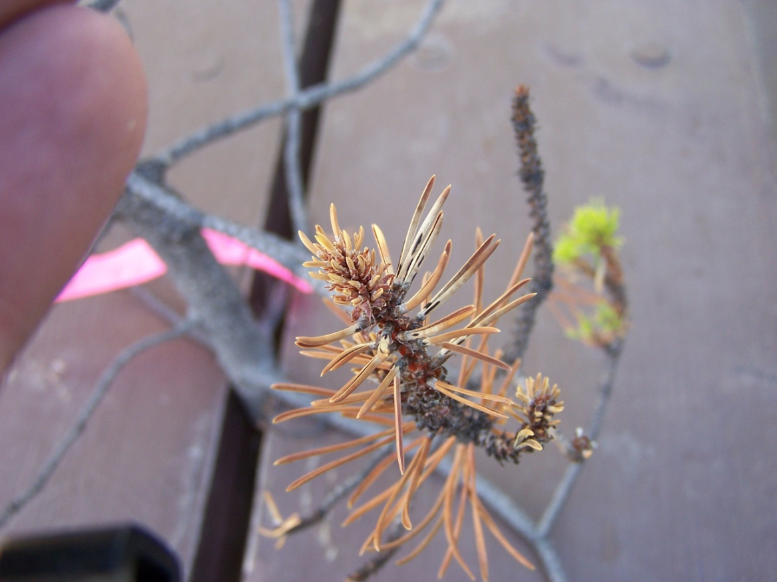
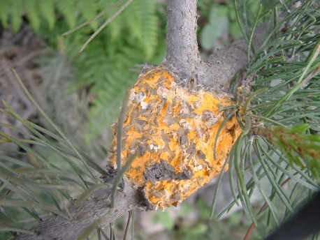
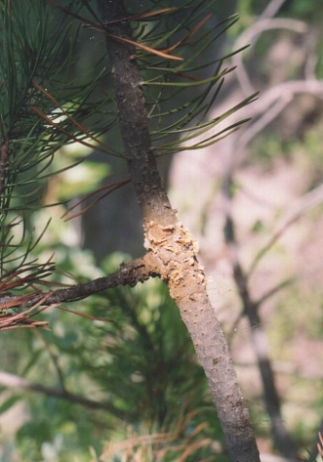
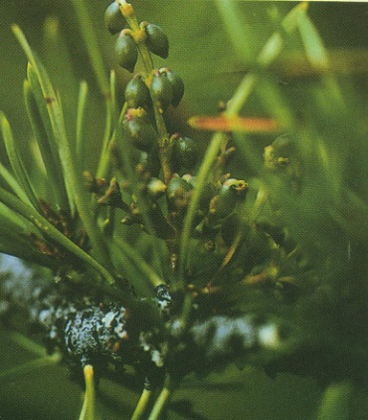
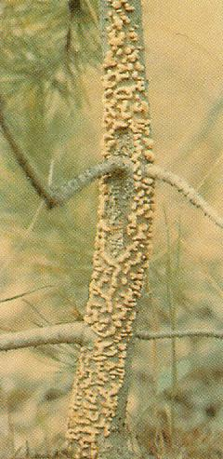
Forest Health

Slide 2
Forest Health Update
Importance of Silviculture surveyors
Review of top pests of young stands
Possible stocking standard revisions
Stem rusts – Quesnel survey data
South Chilcotin Planning Area – Possible Dwarf Mistletoe Impacts
Elytroderma Needle Cast – New Management Bulletin
Forest Health Strategies

Slide 3
Silviculture Surveyors & Forest Health
Gatekeepers of FH data and provide most FH recommendations in the province
RESULTS data has huge potential as a forest health data base (provided data is reliable)
Hazard Rating/Silviculture Planning
Only 2 reasons for an area to be NSR
  Not enough trees to start with
  Forest Health Factor
FH knowledge large part of doing an effective job!

Slide 4
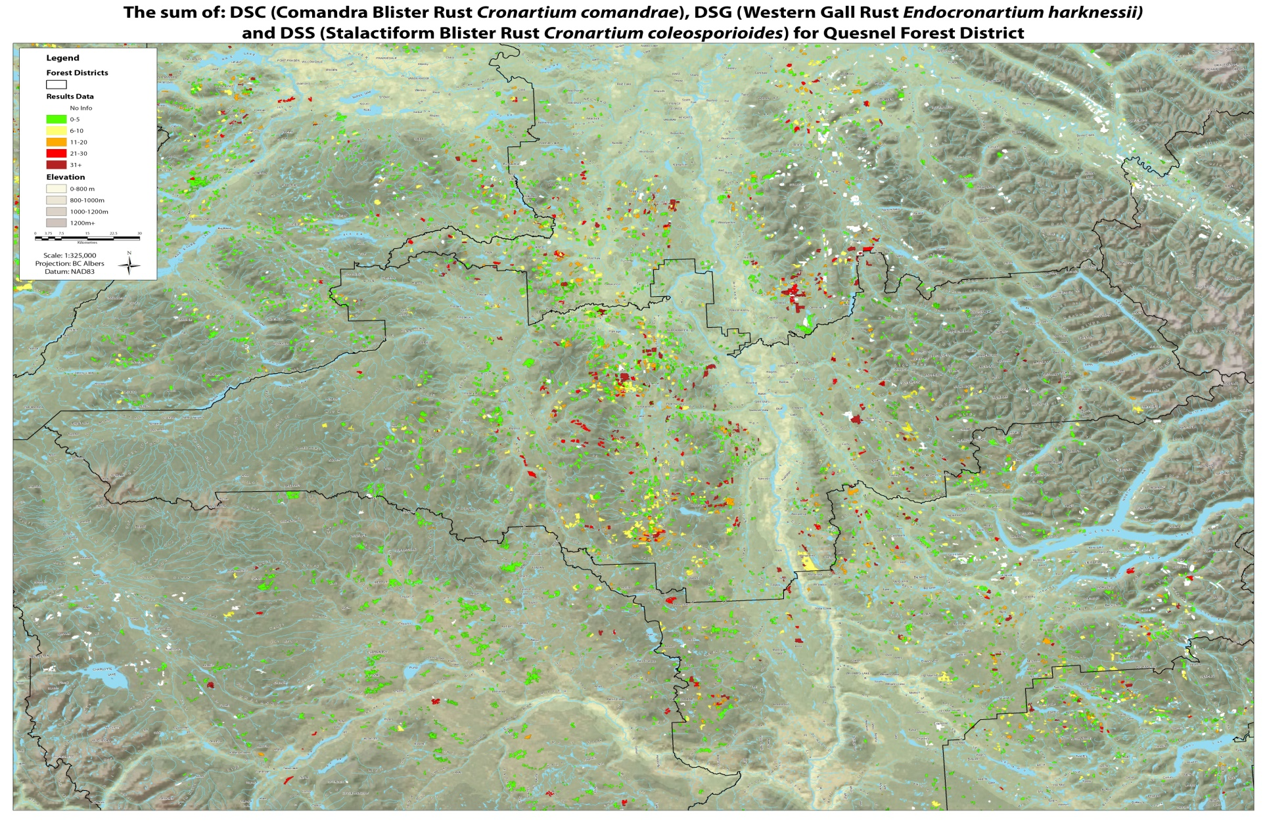

Slide 5
Top Pests in Williams Lake TSA (based on 79 FREP stand development monitoring blocks)

Slide 6
1) Gall Rust 3.1%
2) Snow Press 2.1%
3) Elytroderma Needle Cast 2.1%
4) Forking 1.1%
5) Unknown Mortality 1.0%
6) Mountain Pine Beetle 0.9%
7) Dwarf Mistletoe 0.8%

Slide 7
Forest Health in WLTSA
Highest Incidence of FH by BEC
 |  | Mean Percent Incidence
BEC | n | Elytroderma needle disease DFE | Dwarf Mistletoe DMP | Western gall rust DSG | Mountain pine beetle IBM | Fork UK | Snow press NY | Unknown NK
ESSF | 8 | - | - | 1.0 | 0.4 | 0.4 | 3.6 | 0.5
ICH | 17 | 0.05 | - | 0.3 | 0.3 | 0.7 | 6.0 | 1.2
IDF | 18 | 8.0 | 2.1 | 3.4 | 1.0 | 0.5 | 0.2 | 5.6
MS | 8 | 0.1 | - | 4.7 | - | 3.6 | 0.09 | -
SBPS | 32 | 1.5 | 1.3 | 3.9 | 0.1 | 1.4 | 0.3 | 0.7
SBS | 10 | - | - | 5.2 | 5.2 | 0.3 | 4.4 | 2.1
Total | 93 | 2.1 | 0.8 | 3.1 | 0.9 | 1.1 | 2.1 | 1.0

Slide 8
Possible revisions to stocking standards
a move away from Pli as a preferred species in the ESSF and ICH (high risk for snowpress) and higher densities of Pli in the SBS to account for rusts and other pests.
Higher densities of pine will likely necessitate more reliance on natural regen and less use of lodgepole pine where it wasn’t present previously and may result in better root form

Slide 9
PINE STEM RUSTS
Western Gall Rust
Comandra Rust
Stalactiform Rust

Slide 10

Western Gall Rust

Slide 11
Western gall rust
Highest incidence pest
Infection of elongating leader (can age infections) wave years
Girdling (<5%)/Stem breakage
often right at ground level (tough to see)
No galls <5cm from main stem
# New infections decrease with tree age (77% infection of two year old trees vs. only 11% infection in 10 year old trees)

Slide 12
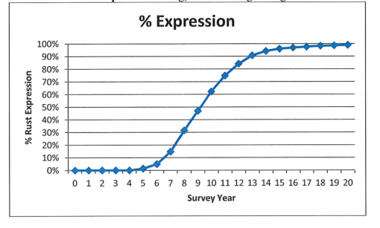
Rust calculator

Slide 13
Gall Rust BEC Hazard Rating
High in SBSdw, SBPSdc, SBPSmk
Mod High MSxv
Mod in IDF & ICH

Slide 14
Cronartium Rusts
Commandra Rust & Stalactiform Rust
Fungi that spend part of their life on a conifer host and part of their life on a flowering plant host
2 very separate and distinct lives on two separate and distinct groups of plants (both are required to complete the cycle)

Slide 15

Commandra Blister Rust
Height:width 1.5-3 : 1

Slide 16
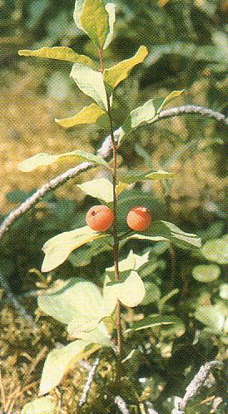
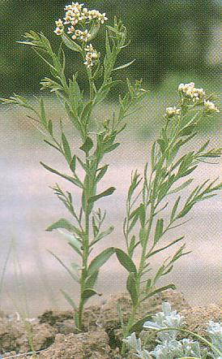
Sandalwood Family
Geocaulon livida Commandra umbellata
(bastard toad flax)
Notes:
Sandalwood Santalaceae root parasites

Slide 17
Stalactiform Blister Rust
Height:width
8-10 : 1
Notes:
10-20 x longer than wide (1.5 for Commandra)

Slide 18
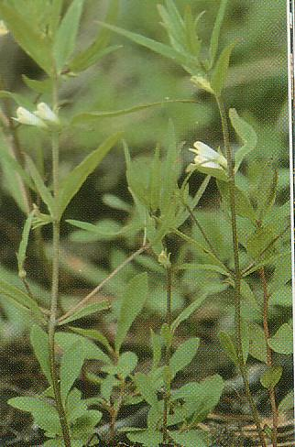
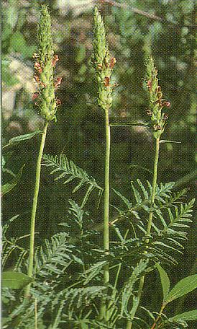
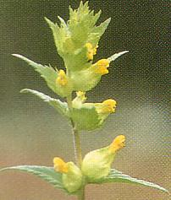
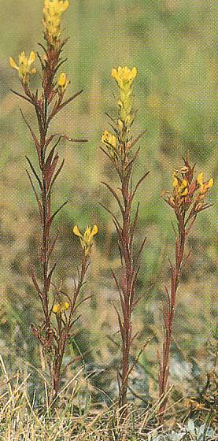
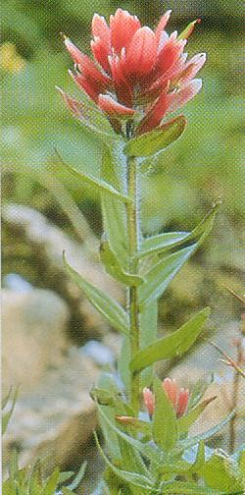
Figworts
Lousewort
Cow Wheat
Yellow Owl’s Clover
Yellow Rattle
Indian Paintbrush
Notes:
Cow-wheat (Melampyrum lineare), yellow owl’s clover (Orthocarpus luteus), lousewort (Pedicularis bracteosa), and yellow rattle (Rhinanthus crista-galli)
Scrophulariaceae

Slide 19
Cronartium Rusts cont’d.
For comandra rust, incidence decreases dramatically as the distance from and alternate host increases from 1 to 5 m
Wave years
Associated squirrel damage

Slide 20
Treatment for Stem Rusts
Spacing
Rust Incidence | Post Thinning | Tactic
<10% | TSS | Space in spring when spores visible
10-20% | TSS + 2x Incidence | Allow for future losses (delay if possible)
>20% | NA | Do nothing

Slide 21
Commandra & Stalactiform Rust – Free Growing Damage Criteria
Canker on main stem or branch canker <60cm from main stem

Slide 22
Cronartium Rusts by BEC
High in SBS & SBPSdc, SBPSmk
Moderate in IDF & SBPSxc

Slide 26
Elytroderma Needle Cast on Lodgepole Pine

Slide 27
Elytroderma deformans
Hosts are ponderosa pine and lodgepole pine
Most reports and pictures are for ponderosa pine
Often goes unrecognized on lodge pole pine despite its widespread occurrence in the IDF & SBPSxc

Slide 28
Needle Cast
Needles infected in current year don’t show symptoms until following year
Previous year’s needles turn red and then fade to a straw colour and fall off
Conspicuous fruiting bodies produced in late summer (one of the easiest foliage diseases to identify in the fall)

Slide 29
What sets Elytroderma Apart?
Can become systemic in shoots
Allows it to survive and reproduce when infection conditions are poor
Stunting can be especially significant if it occurs in the upper crown

Slide 30
Signs and Symptoms
Signs | Symptoms
 | Needles | Branches | Stems
Fruiting bodies form on needles in mid summer | Stunted and yellow current growth | Swollen and upturned branches | Reduced leader growth if systemic infection in upper crown
Appear as short black lines on needles | Needles from previous year turn red in spring then fade to grey and fall off | Systemically infected branches have short internodes | Inconspicuous stem cankers that appear as flattened areas
 | Repeated needle loss results in lions tails | may resemble brooms | Highly tapered stems

Slide 31
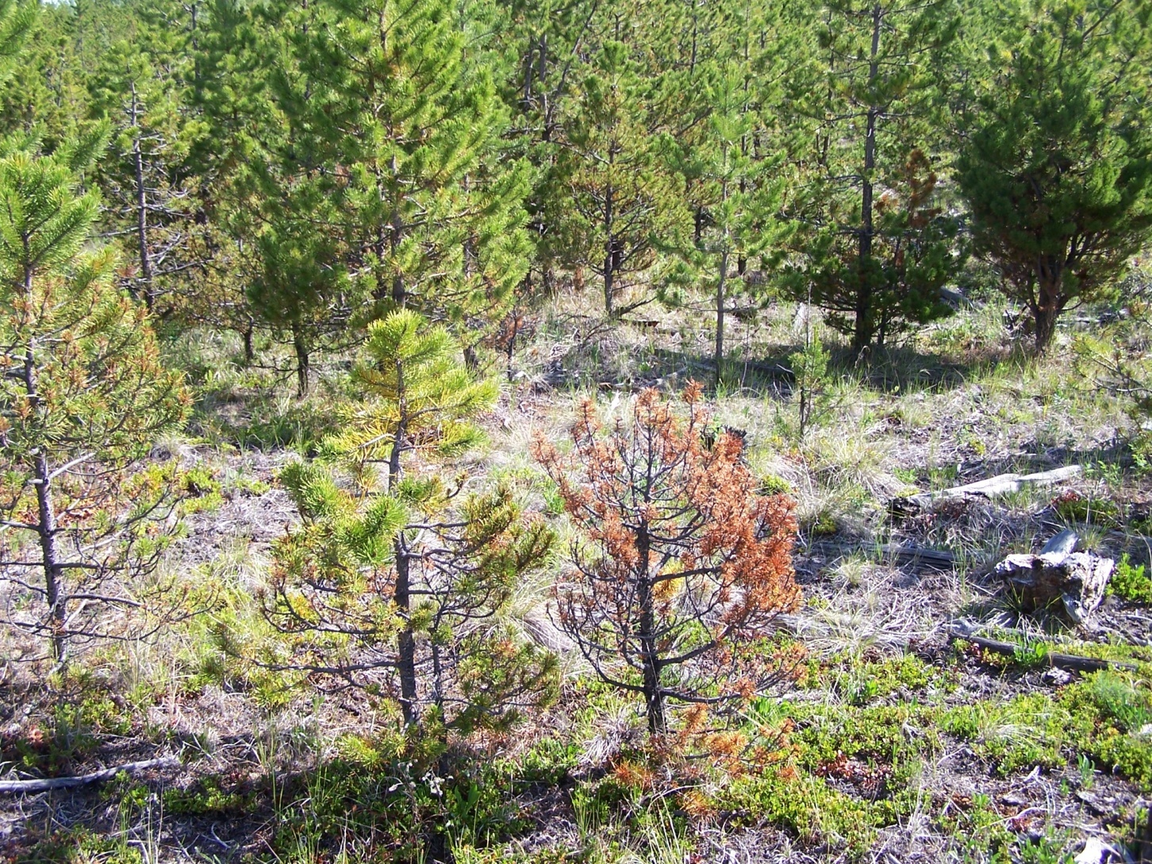

Slide 32
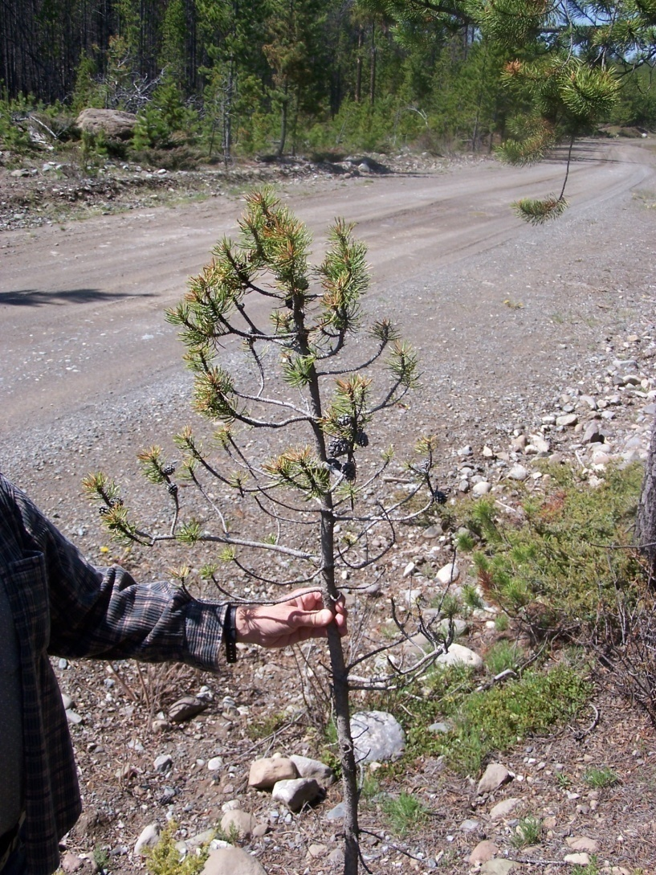

Slide 33
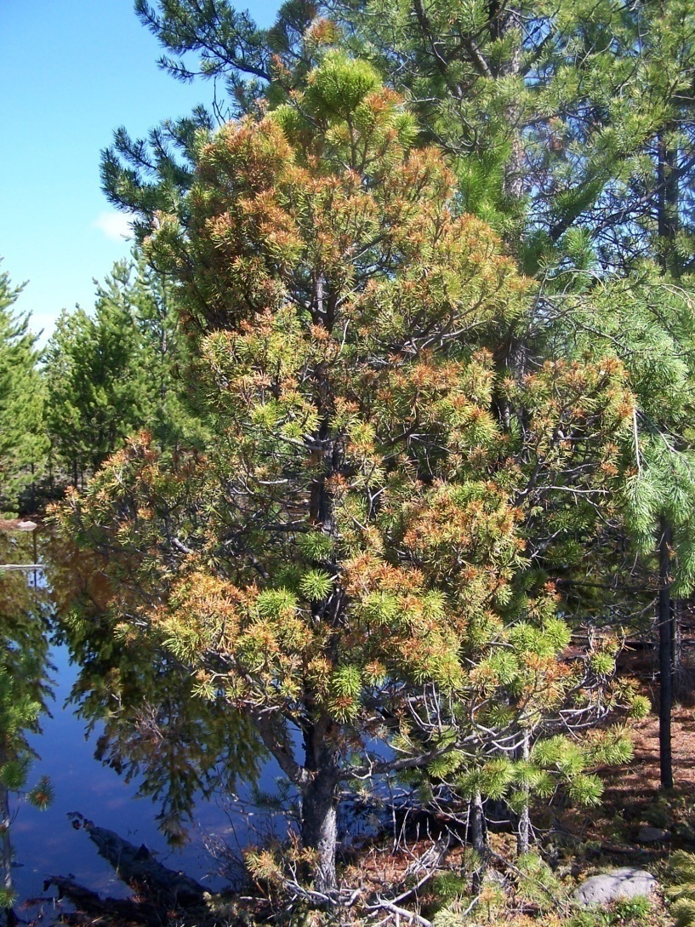

Slide 34
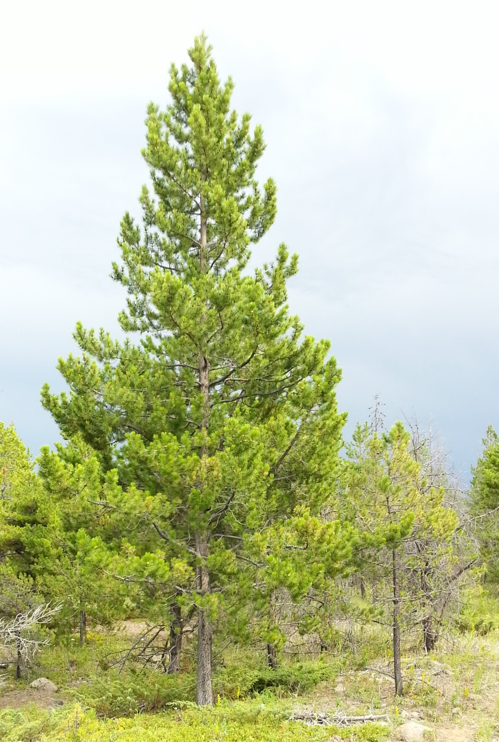
Which tree is older?
(photo courtesy of Bill Layton)

Slide 35
Free Growing Criteria
currently same as for other foliage diseases - 80% defoliation (last 4 years corrected for % live crown)
Can have major implications for determination of site index and meeting minimum free growing heights

Slide 36
Procedure
1) estimate live crown
2) Assess last 4 internodes >50% needles is considered healthy
# Healthy internodes/4 x 100%
3) Live crown x % healthy internodes in 2)

Slide 37
Free Growing Defoliation Standard for Determinate Growth Conifers
% Live Crown |  | % Needle Based on Internodes (>50% | Retention Healthy of needles)
 | 0 | 1 | 2 | 3 | 4
100 | 0 | 25 | 50 | 75 | 100
90 | 0 | 22.5 | 45 | 67.5 | 90
80 | 0 | 20 | 40 | 60 | 80
70 | 0 | 17.5 | 35 | 52.5 | 70
60 | 0 | 15 | 30 | 45 | 60
50 | 0 | 12.5 | 25 | 37.5 | 50
40 | 0 | 10 | 20 | 30 | 40
30 | 0 | 7.5 | 15 | 22.5 | 30

Slide 38
What does 80% defoliation actually mean using this method?
% live crown | Minimum needle defoliation assuming only 4 internodes on tree
100 | Need 50% or fewer needles on all 4 internodes to fail so could have as little as 50% defoliation
80 | Need 50% or fewer needles on 3 of the internodes to fail so could have as little as 37.5% total defoliation
40 | Need 50% or fewer needles on 2 of internodes to fail so could have as little as 25% total defoliation

Slide 39
Elytroderma Needle Cast on lodgepole pine
in British Columbia
David Rusch¹
Introduction
Elytroderma needle cast, caused by the fungus Elytroderma deformans is a foliage disease that affects
lodgepole pine and ponderosa pine. Most literature relating to Elytoderma needle cast deals with
Elytroderma on ponderosa pine. It is not known whether there are host specific subspecies of
Elytroderma but the signs are identical and many of the symptoms are similar on lodgepole pine and
Ponderosa pine. The large brooms caused by Elytroderma on ponderosa pine make the disease fairly
easy to recognize. In contrast, Elytroderma on lodgepole pine often goes unrecognized or is confused
with Lophodermella concolor (another common needle cast) or lodgepole pine dwarf mistletoe.

Slide 40
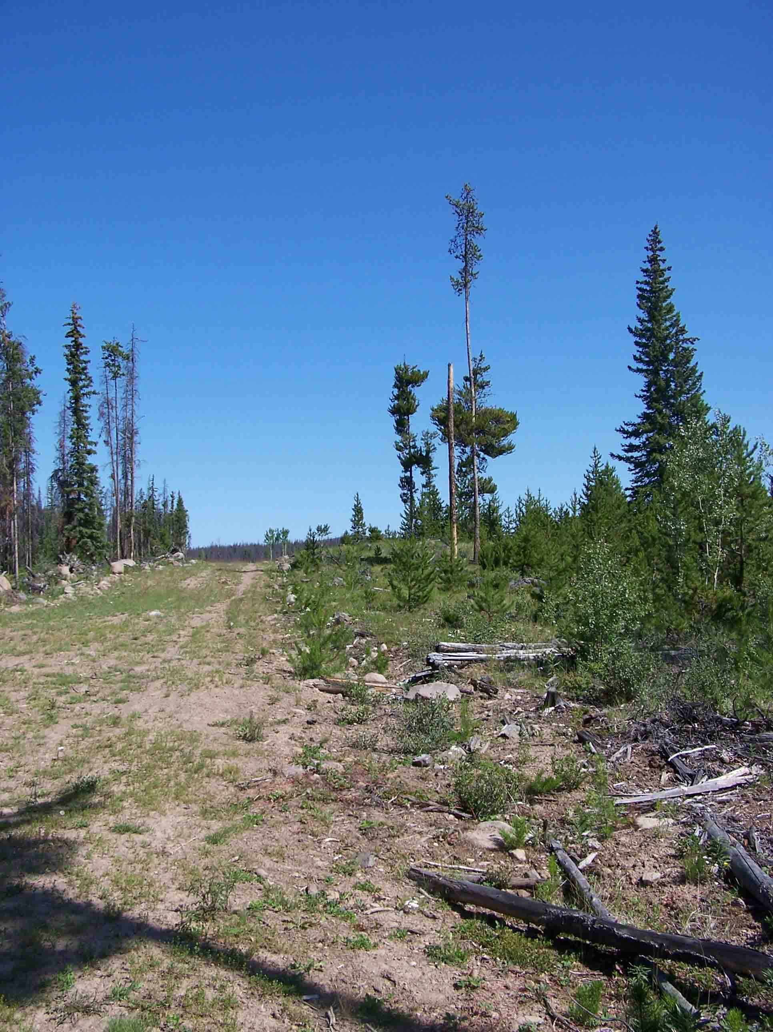
Dwarf Mistletoe

Slide 41
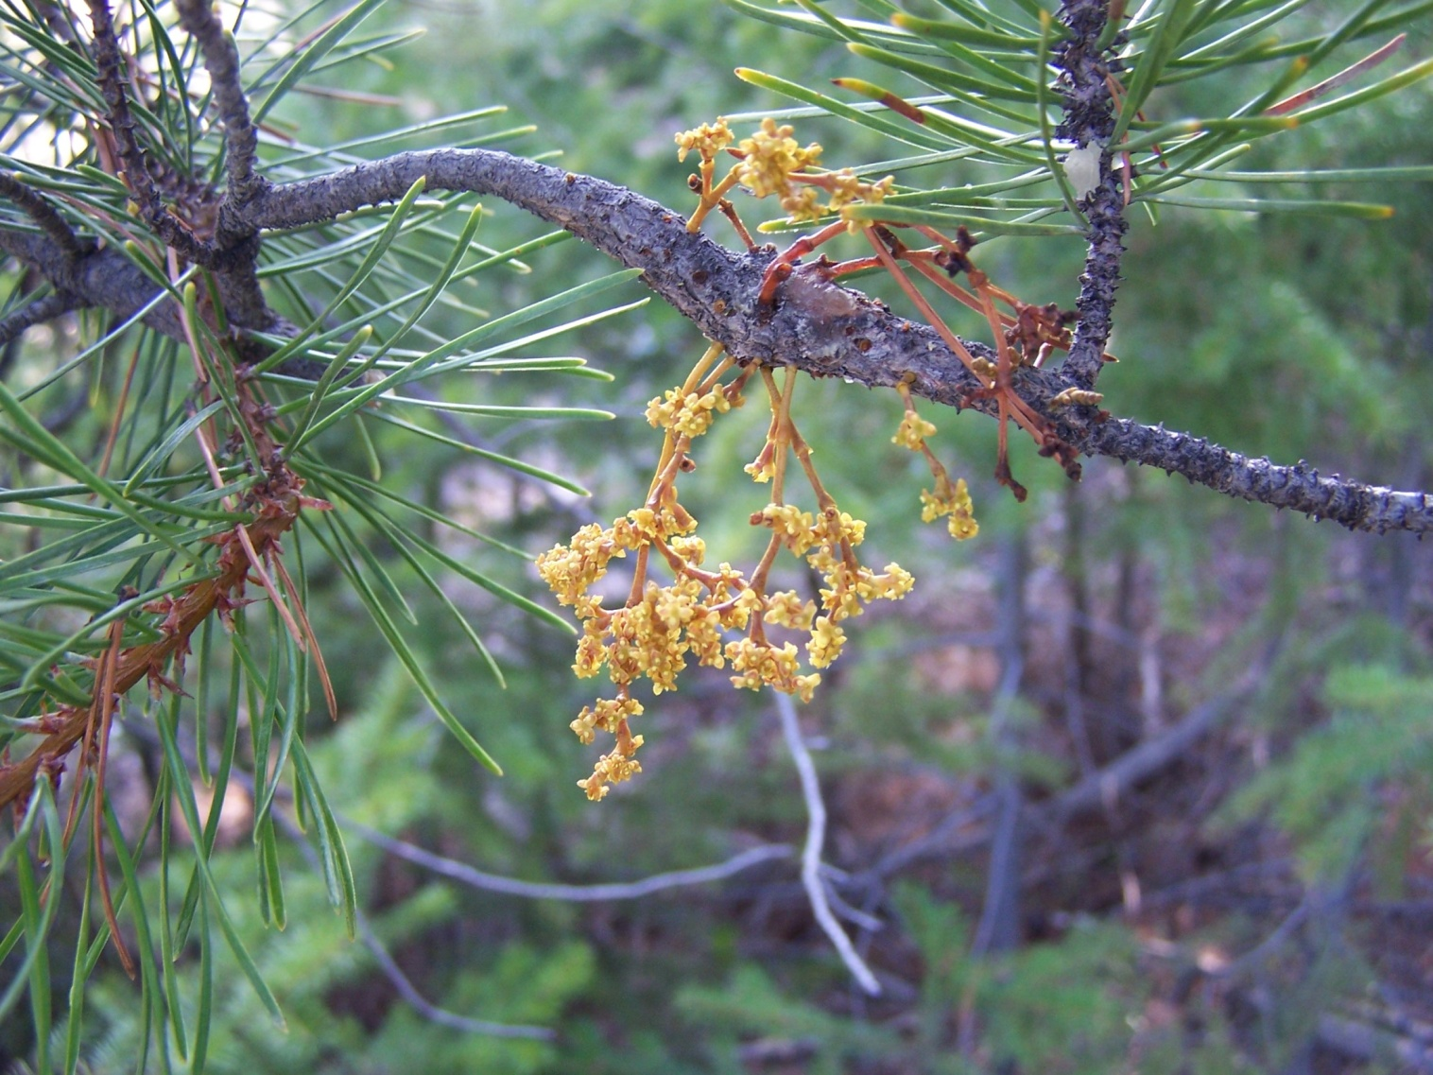
Male Flowers (pollen)

Slide 42
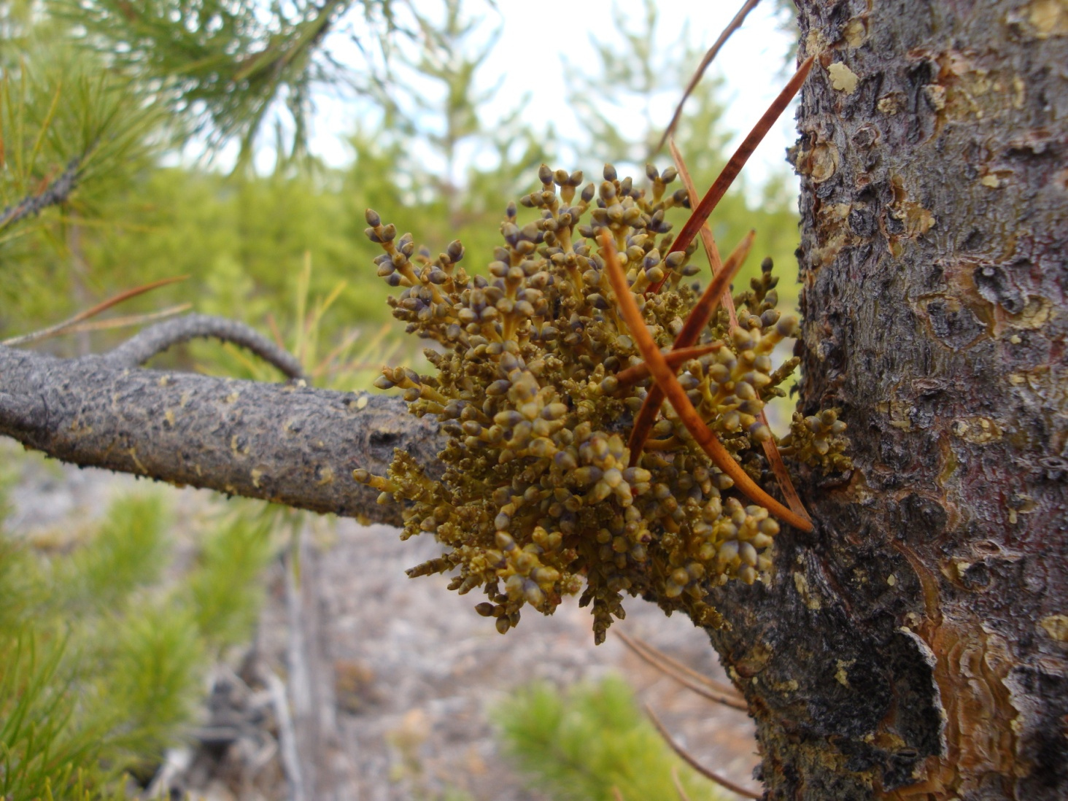
Female Plants
(greener)

Slide 43
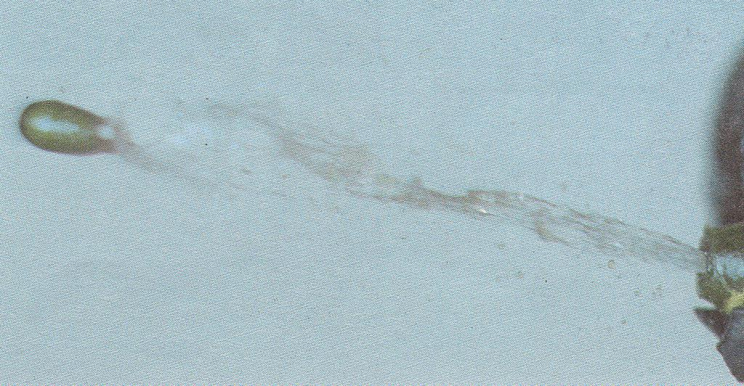
Seed Blast-off

Slide 44
Dwarf Mistletoe by BEC
High throughout host range particularly in SBPSxc and part of IDF
less severe in MS, ESSF, and ICH

Slide 45
Dwarf Mistletoe Management
Management consists of removing overhead seed sources (15 evenly spaced residual/Ha complete infection)
15m first year from overhead source vs. 0.5m/ yr. within open canopy
Species mixes can reduce tree to tree spread
Avoid thinning in Dwarf Mistletoe Stands

Slide 46
Free Growing Criteria
No Mistletoe on tree
No mistletoe on overtopping Pli within 10m (overtopping tree is a tree that is 3x or more the height of the tree being assessed)

Slide 47
Licensee/BCTS Commitments for the South Chilcotin Planning Area
“In the case where protection of mistletoe infested pine is deemed to be necessary to meet a visual screening objective, then the licensee may wish to seek an exemption of variance to their stocking standards allowing mistletoe to be considered as non deleterious to establishing a free growing stand”

Slide 48
South Chilcotin Planning Area
“For the SBPS & IDF, a forest health assessment will occur to evaluate the level of DMP in the stand and appropriate prescriptions developed in consideration of a stands’ moose habitat values.”

Slide 50
BC government ftp site www.for.gov.bc.ca-/ftp/
RSI/external/publish!

Slide 52
Informal Poll
How many people would attend a forest health training session?
When is the best time to hold it?
What would be the best location?
What topics would you like to cover?
What format do you prefer?
  Office/field/informal/ID/management/exercises/pest challenge?

